Slide 1
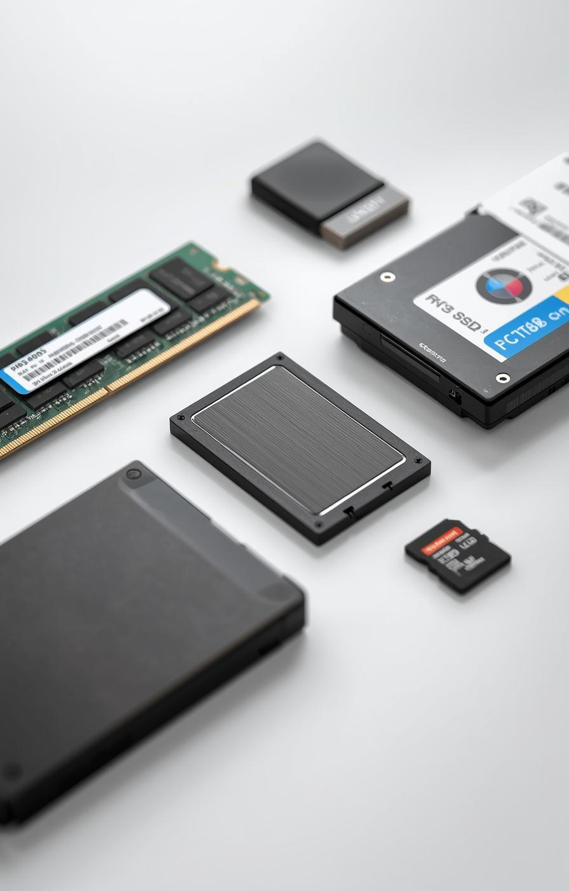

Storage Devices in Computer Systems
Hana Aden

Slide 2
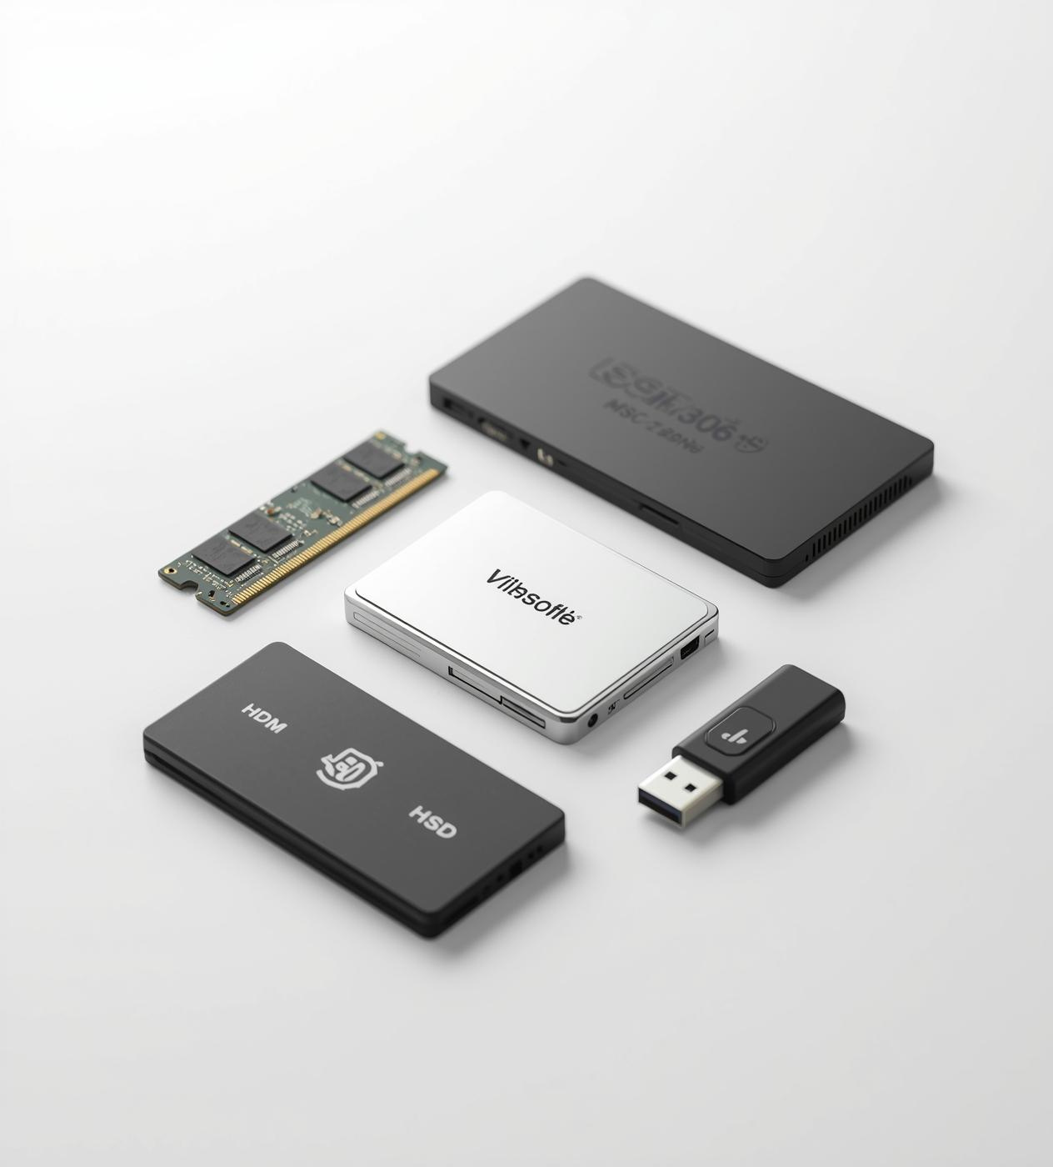
Overview of Storage Devices
Storage devices are essential components in computer systems, enabling data saving, retrieval, and manipulation. They are classified into primary and secondary types, which serve distinct purposes in data management.

Slide 3
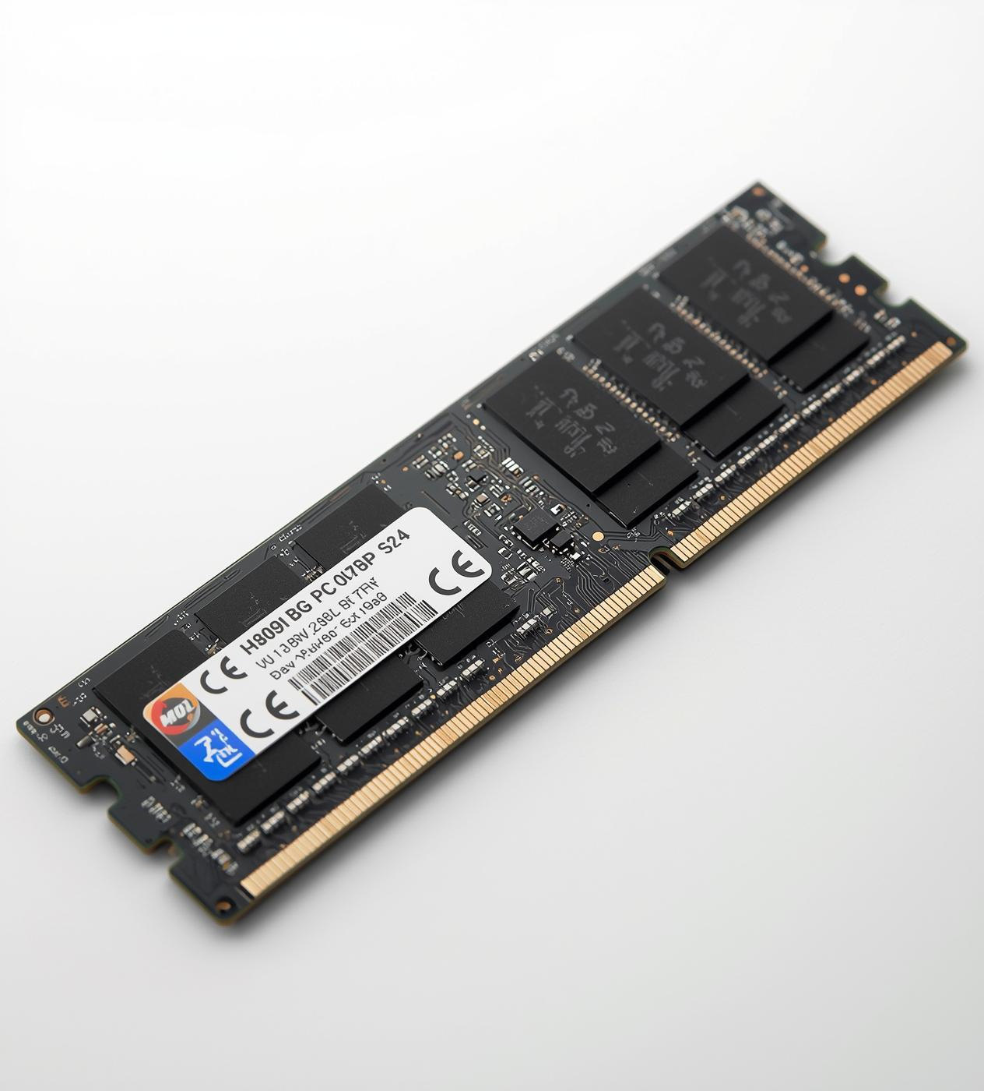
Understanding RAM: The Heart of Speed
RAM (Random Access Memory) is a volatile memory crucial for temporary data storage during active processes, enabling fast read/write operations, supporting multitasking, and enhancing overall system performance in computers.

Slide 4
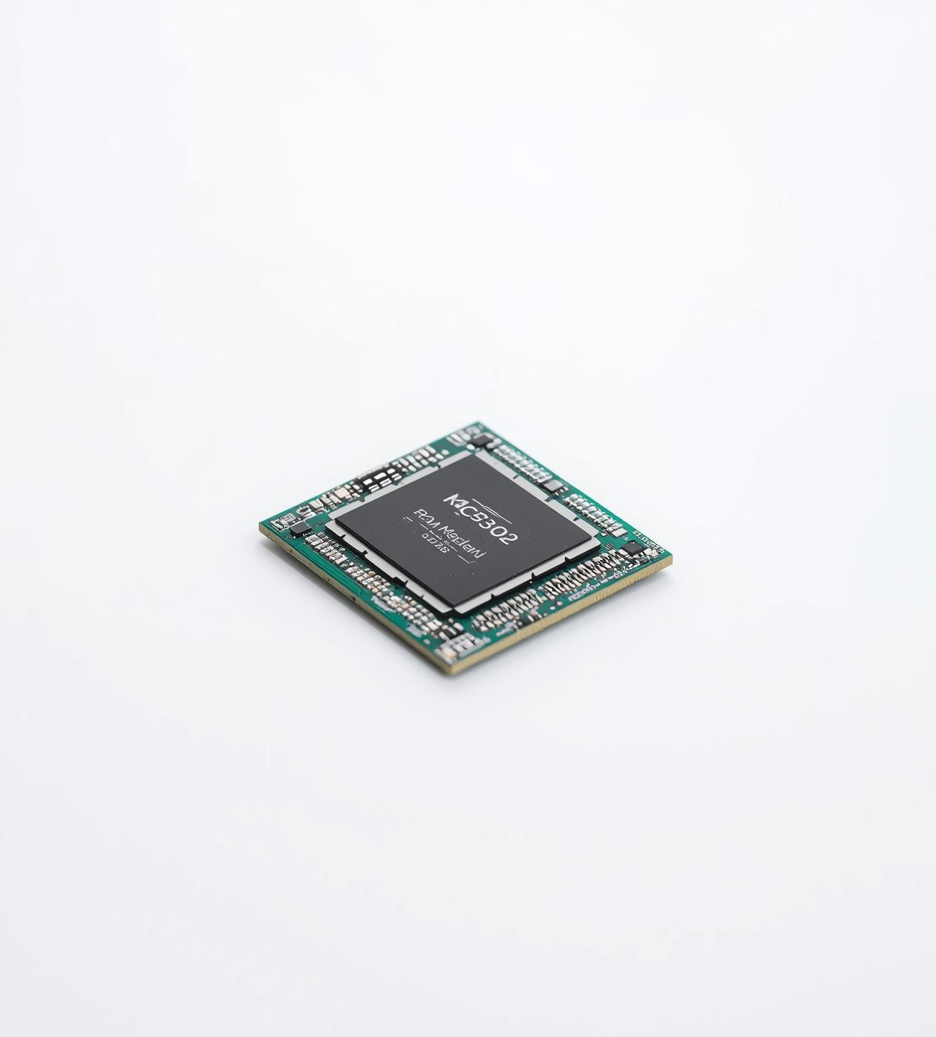
Understanding Read-Only Memory (ROM)
ROM is a non-volatile memory type essential for storing permanent instructions. It retains data even without power, crucial for booting systems and ensuring reliable startup processes in embedded devices.

Slide 5
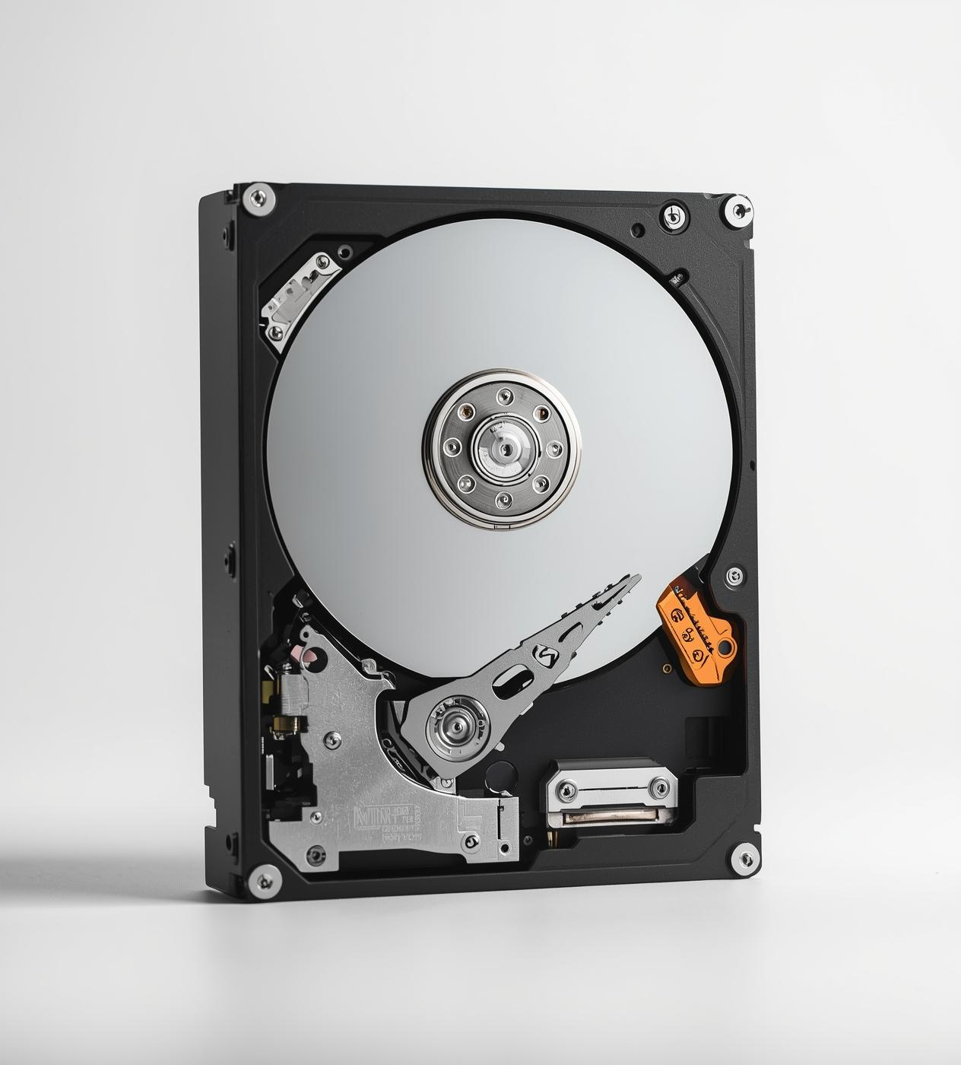
Understanding Hard Disk Drives
Hard Disk Drives (HDD) utilize magnetic storage on spinning disks, offering large capacity and cost-effectiveness for permanent file storage and retrieval, making them essential in desktops, servers, and backup solutions.

Slide 6
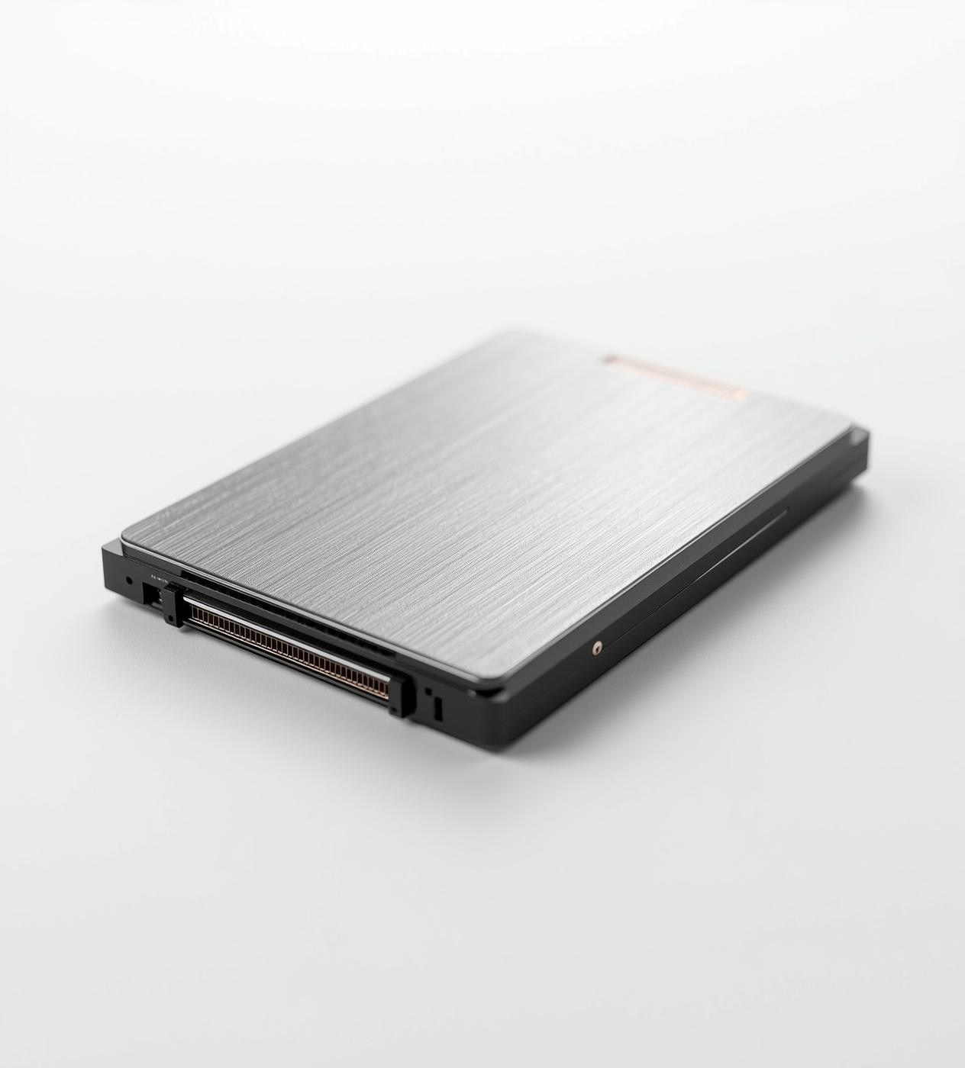
Understanding Solid State Drives
SSDs utilize flash memory for faster data access and increased durability compared to traditional HDDs. They significantly reduce boot and load times, enhancing performance in laptops and gaming PCs.

Slide 7

Flash Drives and Memory Cards
Flash drives and memory cards provide portable storage solutions for data transfer and backup. Their compact size enhances device expansion, making them ideal for personal use in cameras and mobile devices.

Slide 8
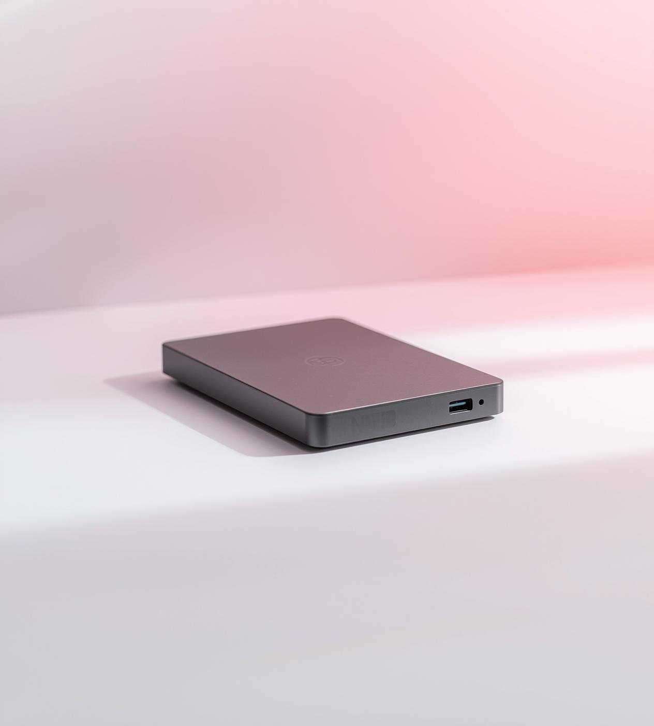
External Hard Drives Explained
External hard drives offer high-capacity portable storage for backing up data and transferring large files. They connect via USB or other interfaces, making them essential for both personal and business use.

Slide 9

Significance of Storage Devices
  Enable data retention for both temporary and permanent needs
  Support multitasking and efficient program execution in systems
  Essential for backups, recovery, and data portability across devices

Slide 10
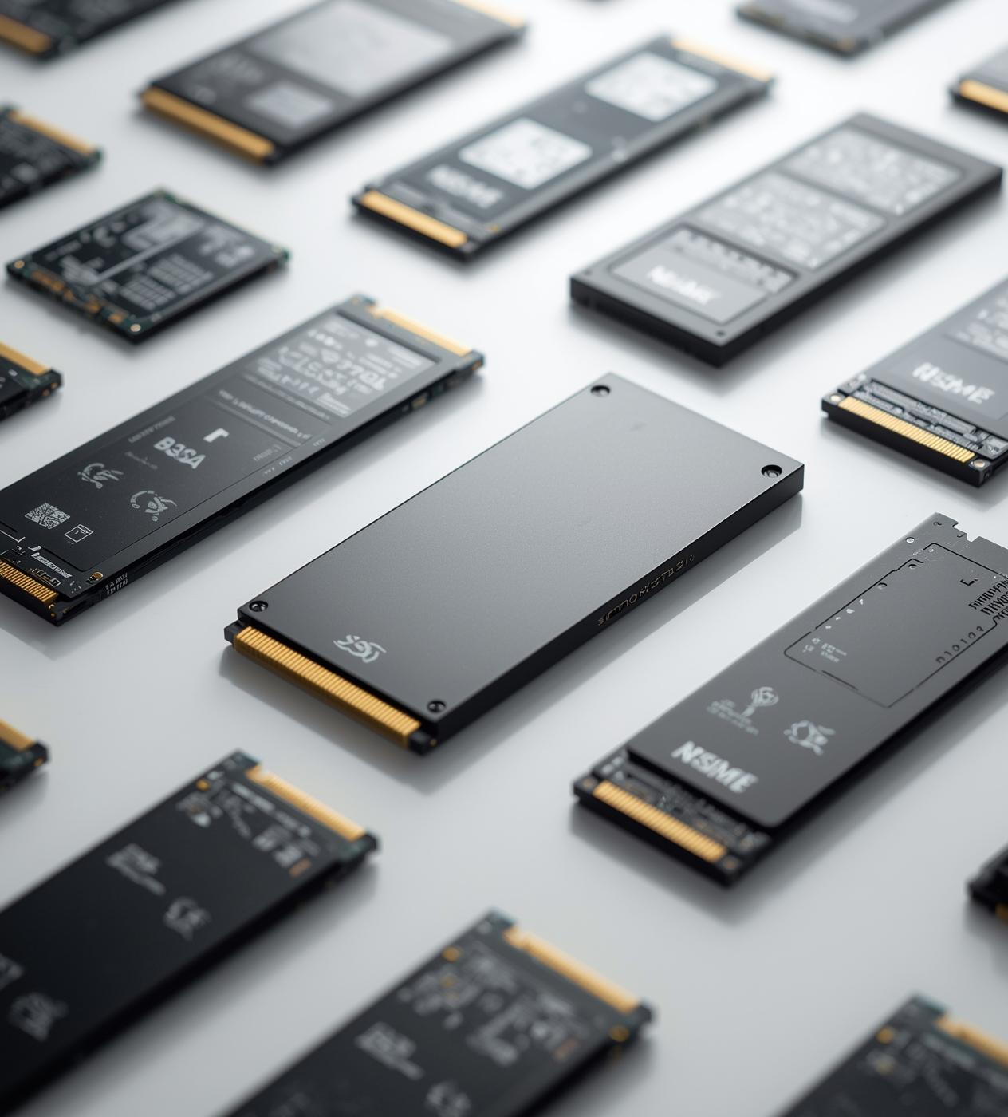
Emerging Technologies in Storage
The future of storage devices includes increased speed and reliability with SSDs replacing traditional HDDs, widespread adoption of cloud storage solutions, and the development of ultra-fast NVMe drives enhancing data accessibility.

Slide 11
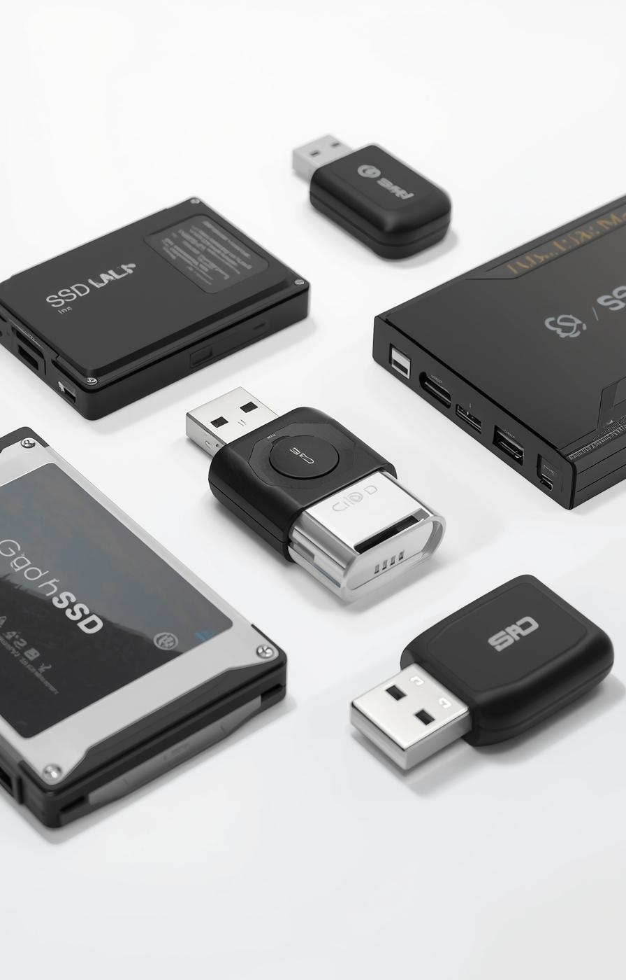

Thank You
Exploring the world of storage devices

